Slide 1
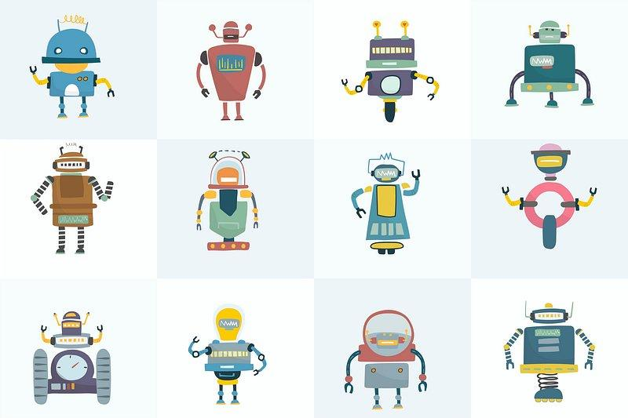
Reinforcement Learning
INTRODUCTION TO
AGENDA
What Is Reinforcement Learning?
Markov Decision Process MDP
Evaluating Policies
Aside: Preliminary Machine Learning Background
Code Walkthrough: DQN

Slide 2
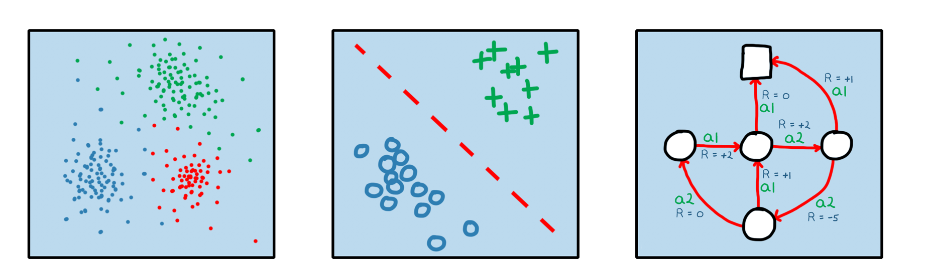
What Is Reinforcement Learning?
INTRO TO RL
Machine Learning
Supervised Learning
Unsupervised Learning
Reinforcement Learning

Slide 3
What Is Reinforcement Learning?
INTRO TO RL
Reinforcement Learning (RL) is a type of machine learning where an agent learns to make decisions by interacting with an environment. The agent receives feedback from the environment in the form of a reward or a penalty and learns from this feedback to make better decisions. The goal is to maximize cumulative reward over time.

Slide 4
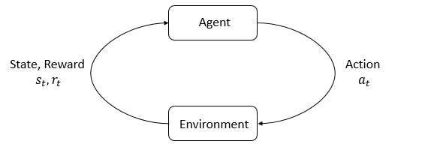

Markov Decision Process MDP
INTRO TO RL
Trajectory/Episode: a sequence of states and actions representing a single run of the agent interacting with the environment
Policy (π_{θ}): a mapping from states to actions that defines the behaviour of the agent in the environment
The goal of reinforcement learning is to find the optimal policy π_{θ}*.

Slide 5
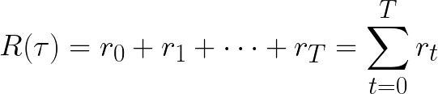
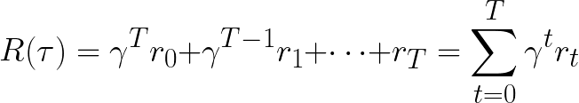


Evaluating Policies
INTRO TO RL
(Undiscounted) Return:
Discounted Return:
State-Value Function:
Action-Value Function:

Slide 6
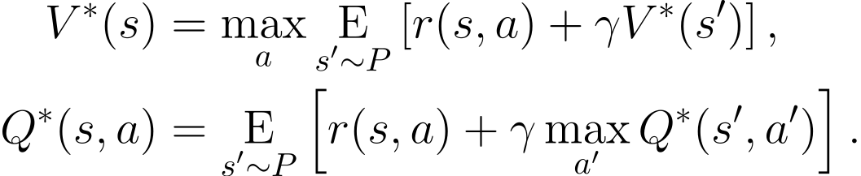
Evaluating Policies
INTRO TO RL
Bellman Equations:
2 | 1 | s_{T}
3 | 2 | 1
4 | 3 | 2
s₀ | 4 | 3

Slide 7
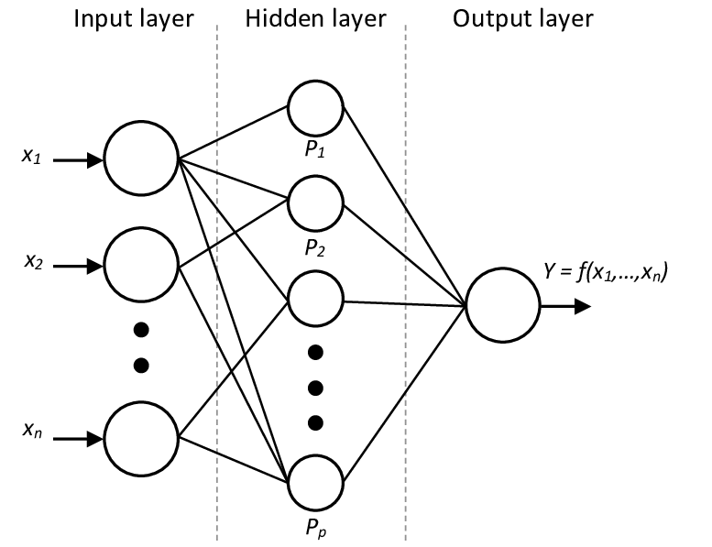
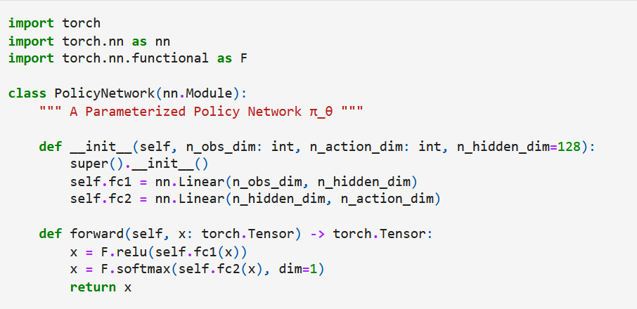
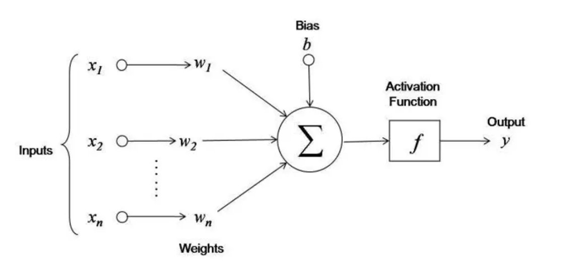
Aside: Preliminary Machine Learning Background
INTRO TO RL
BGK #1: A neural network is a function approximator

Slide 8
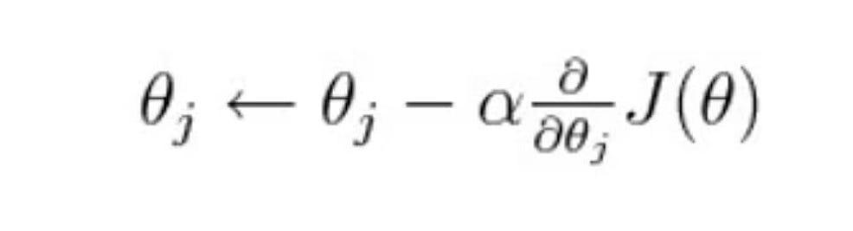
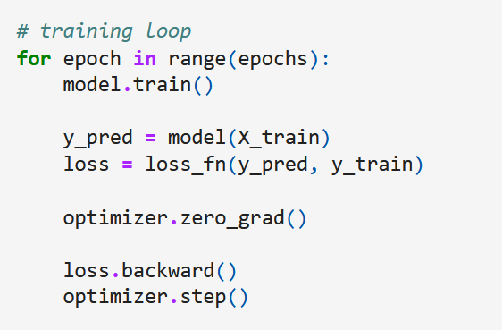
Aside: Preliminary Machine Learning Background
INTRO TO RL
BGK #1: A neural network is a function approximation
BGK #2: This function approximation is fine-tuned via gradient descent

Slide 9
Code Walkthrough: DQN
INTRO TO RL
code: https://github.com/sabrinahirani/reinforcement-learning-w-gym/blob/main/DQN.ipynb

